Slide 1
Monitoring GPUs at scale for AI/ML and HPC clusters
Bharti Agrawal, 8/19/20
Notes:
Hi everyone, welcome to my talk on Monitoring GPUs at scale for AI/ML and HPC clusters. My name is Bharti Agrawal, I am a software architect at NVIDIA working on Logging and Monitoring stack in the NVIDIA SatuvnV Datacenter

Slide 2
The Problem
We manage our SaturnV data centers using Kubernetes
We have 1000s of GPU servers
We have 100s of Users running ML training
We have terabytes of data
Many stakeholders with observability needs
How to support monitoring at this scale?
Notes:
We manage the NVIDIA SaturnV Datacenter using kubernetes.
This supports 1000s for GPU servers which supports 100s of Users running their Machine Learning training jobs. These jobs use terabytes of data.
We also have stakeholders and other users with observability needs.
How to support monitoring at this scale?

Slide 3
AGENDA
NVIDIA SaturnV Datacenter Users, Size and Scale System Requirements
The Stack and Architectures Scale Challenges User Views
Notes:
For our Agenda today we will first look at what the Nvidia SaturnV Datacenter is.
Then we will review the various users we have to support for Observability.
We will look at the size and scale of the data center and the requirements that come out of that.
Next we will go over the Stack and a couple of the architectures of the stack that we setup to meet these requirements. We will also cover some details of GPU metrics collection.
We will look at the scale challenges we hit and how we solved for them.
Finally we will look at some example user views

Slide 4
Nvidia saturnV datacenter
Notes:
Lets look at the Nvidia SaturnV Datacenter

Slide 5

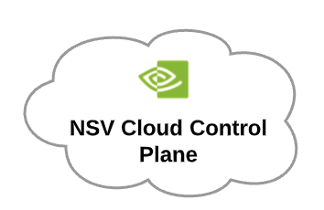
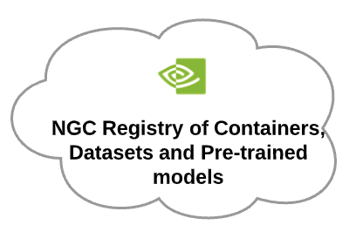
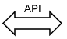
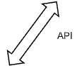
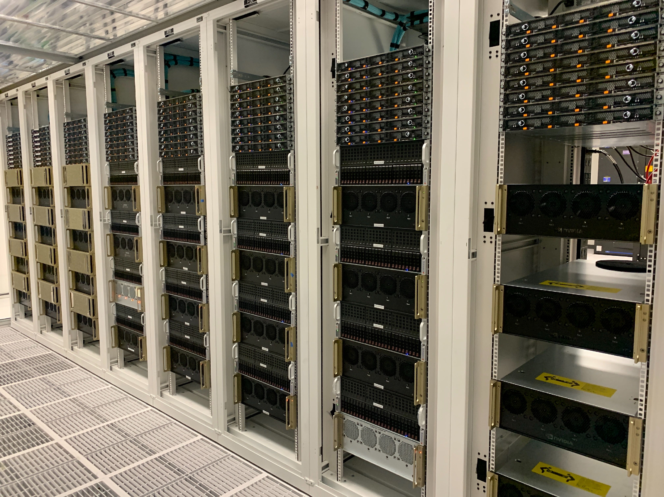
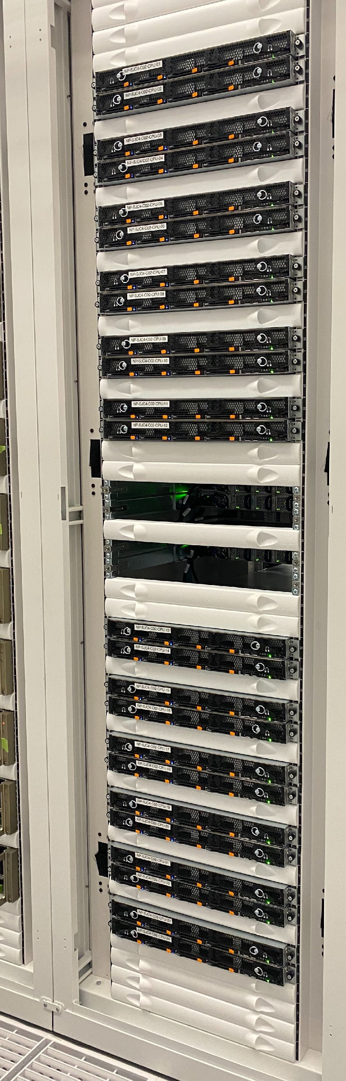
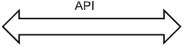
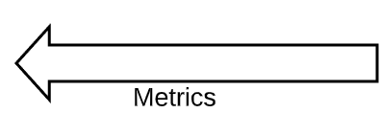
NVIDIA Saturnv datacenter
AI/ML HPC users
CPU Control Plane
Running k8s and Scheduler and monitoring and logging stack
NVIDIA GPU cluster
Notes:
So what is the NVIDIA SaturnV Datacenter, or NSV for short.
At NVIDIA we have a lot of users who need to run their Artificial Intelligence and Machine Learning jobs on a GPU server. They can setup their own server to do this but this limits them in the size of job and the technology. It would also add cost to maintain these nodes.
In order to facilitate these users, our team setup clusters with 100s of GPU nodes with the latest technology, for the users to deploy their jobs on.
We also added a CPU control plane to allow us to add a scheduler for the user jobs and to support observability.
On top of this we added a web portal, the NSV Cloud Control Plane, for the users to interact with.
The users use the NSV API to schedule their jobs in the NSV Cloud Control Plane,
this request is then sent to the Scheduler which schedules the jobs on the GPU nodes.
Metrics are sent from the GPU nodes to the Monitoring stack.
The users are also able to leverage the NGC Registry which contains containers, dataset and pre-trained models for them to use.
This is great! Users get the latest technology and are able to deploy their jobs and be guaranteed that they will have resources to run on. However we need to ensure we can meet this guarantee. Observability is the key to this guarantee. Let's look at the setup and the use cases we need to support for this.

Slide 6
USERS, size and scale
Notes:
Nets, lets look at the users, the size and the scale

Slide 7
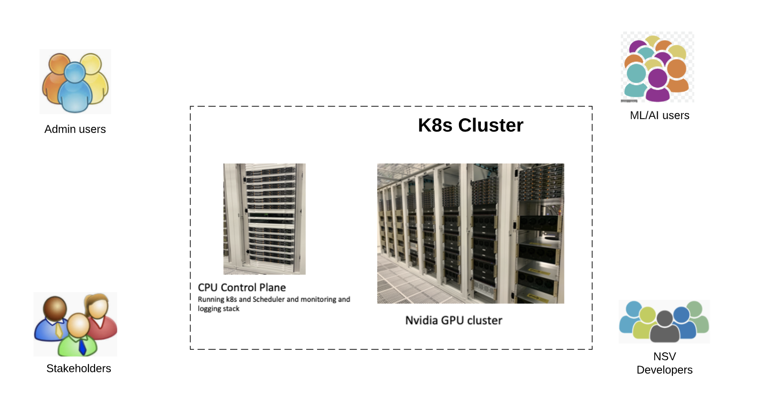
NSV Datacenter users
Notes:
As we saw in the NSV Datacenter we have the Kubernetes cluster with GPU nodes and the CPU Control Plane. From the observability perspective, apart from the end users we have various users accessing this system.
We have the admin user who would like to get a view on the overall health of the cluster and get real time alerts in slack and pager duty.
We have the Machine Learning /Artificial Intelligence end users who would like to see the performance of their jobs in terms of the job telemetry and the application telemetry.
We have the stakeholders, these are the product managers, manager, architects and other org leaders, who would like to get the overall occupancy and yield of the system for capacity planning purposes.
Then we have the NSV Developers, these are developers like me who worked on the scheduler and the observability stack. These users would like to be able to get a view into the health and resource usage of the components and be able to root cause issues.

Slide 8
Users and requirements
Users | Use Cases | Requirements
End User | How efficiently their job runs | Job resource usage in NSV Cloud Control Plane. Application metrics in NSV Cloud Control Plane.
Admin User | Monitor health of datacenter (DC). Realtime notifications on incidents. Logs for debugging. | Centralized system metrics and logs. Alerts on slack and pager duty. HA and Horizontal scaling.
Stakeholder | Occupancy, health, efficiency of DC. User experience and growth. Capacity planning. | Metrics aggregation at job level. Data Retention for 1 year. Yield and efficiency of the system.
NSV Developers | State of NSV components. Logs for debugging. | NSV Component metrics. NSV Component logs.
Notes:
How do these use cases map into requirements?
For the end users who want to see how efficiently their jobs are running in terms of resource usage and their custom metrics, we need to collect the resource and application metrics and send them to the NSV cloud control plane.
For the NSV Admin user who wants to monitor the overall health of the system, get real-time notifications on incidents and be able to root cause them effectively, we need to centralize the metrics and logs in real-time. The real-time alerts need to be sent to slack and pager duty. We also need to ensure that the stack is highly available and can scale horizontally as nodes get added to the clusters.
For the Stakeholders, we want to get the metrics aggregation at the job level and retain these for 1 year. We also need to show yield and efficiency of the system in a dashboard and weekly reports.
Finally, for the NSV Developer we need to collect and centralize the metrics and logs of the NSV components.

Slide 9
Size and scale
Multiple production clusters
Up to 600 nodes per cluster, 250 of which contain 2000 GPUs
Non prod clusters
Dev, QA, stage and canary clusters: CICD process for promotion
Clusters keep growing
Notes:
Our system needs to supports multiple production clusters each with up to 600 nodes, 250 of which contain 2000 GPUs
Along with this we have several non prod clusters where we need to support the same monitoring and logging stack. We use CICD process for promotion to manage these
These clusters growing clusters.

Slide 10
SYSTEM Requirements
Notes:
Lets go over the system requirements next.

Slide 11
System requirements
Functional Requirements
Centralize Metrics and Logs
Visualization and searchability
SLA of <1 min. latency for metrics
Export to external systems
Retention of metrics (up to 1 year)
Non-functional requirements
Data Durability, HA, Scale, Resilience
Send data out securely
Notes:
From all this we get the following functional requirements. We need to centrally collect metrics and logs for all levels - cluster, node, Kubernetes system and jobs, at scale.
We need to meet the SLA to allow users to get real time metrics i.e. <1m from node to system.
These metrics have to be forwarded to external web systems.
The growing data needs to be retained to support long term views.
The nonfunctional requirements include data durability, i.e. no data loss.
The system should be Highly Available.
The stack should scale as we add nodes to the cluster, and it should be resilient
We also need to keep security in mind when we send metrics to external cloud systems.

Slide 12
STACK AND ARchitecture
Notes:
We will look at the Stack and the Architecture Next.

Slide 13
The Stack
Component | What it gives us
Kubernetes | Orchestration and life cycle management
Kubernetes device plugin | For GPU enablement under Kubernetes
NSV Scheduler | Kubernetes Custom Resource Controller (CRD)
NVIDIA DCGM | Data Center GPU Manager (DCGM)
Prometheus Operator, | Robust Real-time collection, visualization and alerting for metrics, native to Kubernetes
InfluxDB | Persistence in cluster, metrics exporting
Thanos | Data Durability
SwiftStack | S3 Compatible Object Storage
Fluentd | Logging agent
Nginx | Ingress
Graylog | Logging
Notes:
These are the components our stack consists of.
We decided to use Kubernetes for the orchestration and life cycle management of the system.
The system uses the Kubernetes device plugin for GPU enablement under Kubernetes.
We developed the NSV Scheduler which is a Kubernetes custom resource controller
For the Observability stack we have the NVDIA Data Center GPU Manager component for GPU metrics. We decided to use Prometheus Operator for metrics collection and alerting. This stack comes with Grafana for visualizing. This is native to Kubernetes and widely used with a lot of community support behind it. It is highly performant in collecting metrics and writing to remote storage.
To support in cluster data persistence, we use InfluxdB.
Thanos with Swiftstack objectstore is used for data durability and storage.
Fluentd agent is used for the log collection and sending logs to the central logging service which can be influxdb or Graylog.
We use Nginx Ingress Controller for exposing the stack endpoints to the users.
In some clusters based on the requirements we are using Graylog instead of Influxdb for logs

Slide 14
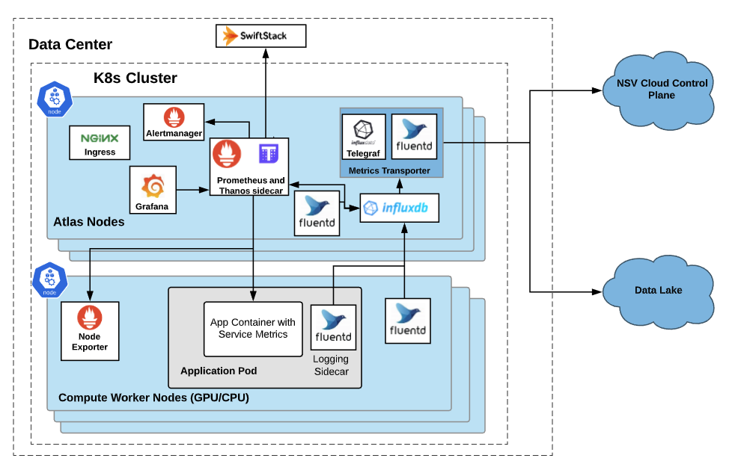
Architecture 1
Notes:
This is how it all comes together in terms of the overall architecture. We use all open source components.
On the left side we see how metrics are centralized. Node exporter is running on the Compute worker nodes. These can be either GPU or CPU nodes. It exposes node level and GPU metrics. Applications can also expose service metrics at an endpoint.
These metrics are scraped by Prometheus running in the CPU control Plane, at a 30 sec interval. These metrics are sent to influxdb via the Prometheus remote write, Prometheus will also read from Influxdb, for in cluster persistence. From here they are forwarded to the Metrics transporter via the influxdb subscription setup.
The transporter then forwards them to the external cloud systems. Having the metrics go to a Transporter on a different node from the source node, with a separate vpc, allowed us to introduce a level of security when sending metrics out. Additionally we used auth for sending metrics to the external systems.
We also have Thanos sidecar running on the system that sends these metrics to SwiftStack objectstore for long term storage and data durability.
Grafana is used to visualize these metrics for the NSV Developers and the Admin Users.
The alerts evaluated by Prometheus are forwarded to Alertmanager, which will forward them to Slack and Pager Duty.
On the right side we see the flow for the logs. A fluentd daemonset is running on the nodes to collect and send system logs to influxdb. An application can add a fluentd logging sidecar to send their logs to this centralized service as well.
The users will see this data on the NGC UI and the Stakeholders will use the ELK stack on the Data Lake to visualize the job metrics. Stakeholders also get weekly Yield and Showback reports that use the data from the data lake.

Slide 15
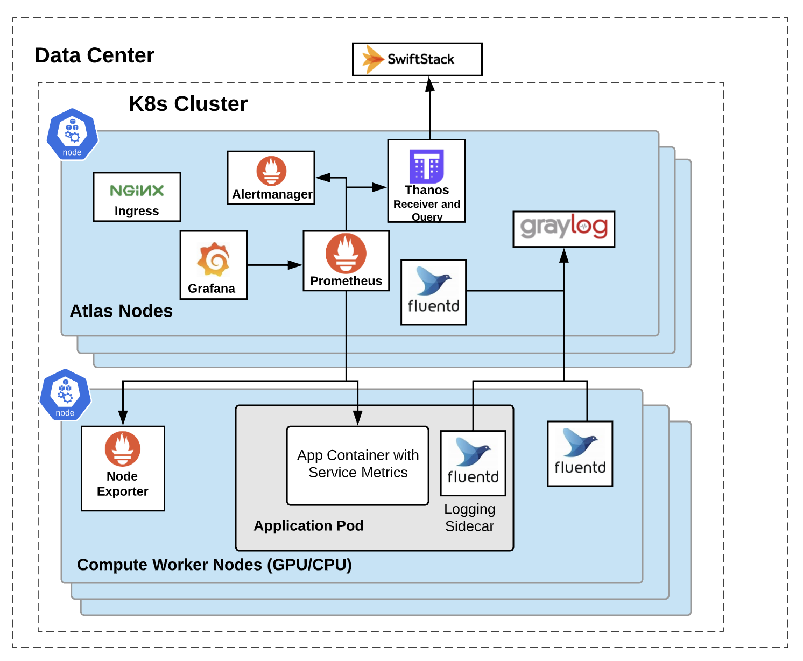
ARCHITECTure 2
Here we do not send metrics to external systems
Notes:
Here is a variation of the Architecture we setup for another cluster.
The only change here is that we do not need to send metrics to external systems, so we were able to replace influxdb with Graylog for the logs. This has scaled better for our loads.
We also introduced Thanos receiver to give us a better data durability solution.
As you can see, we were able to adapt our architecture for a slightly different set of requirements.

Slide 16
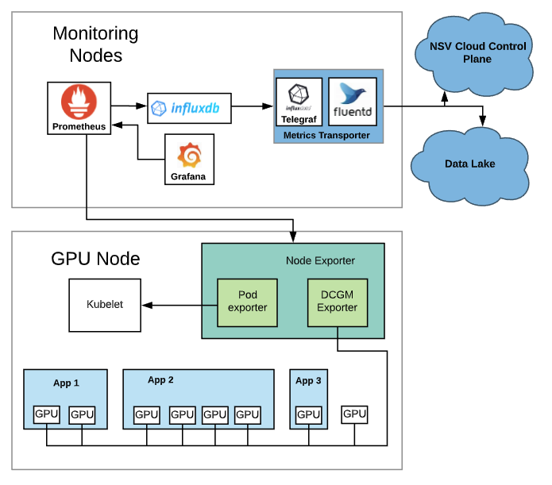
Gpu metrics flow
Some popular metrics include:
GPU Active
TC Active
GPU memory
GPU Power
GPU Temperature
Notes:
Lets take a quick at the details of how we collect GPU metrics.
In this diagram you can see that on the GPU node at the bottom we have several jobs running. Node Exporter pod has the Data center GPU Manager (or DCGM) exporter as a container that collects GPU metrics from the DCGM library running in the pod as well.
To get pod level detail in these metrics we have the pod exporter that talks to kubelet to see which Pod is using which GPU. With this integration we can get the GPU metrics per Job.
Prometheus, in the Monitoring Nodes, will scrape these metrics every 30 seconds.
These then get sent via influxdb to the the Metrics transporter and from there to the cloud systems.
Some of the key GPU metrics are listed here.

Slide 17
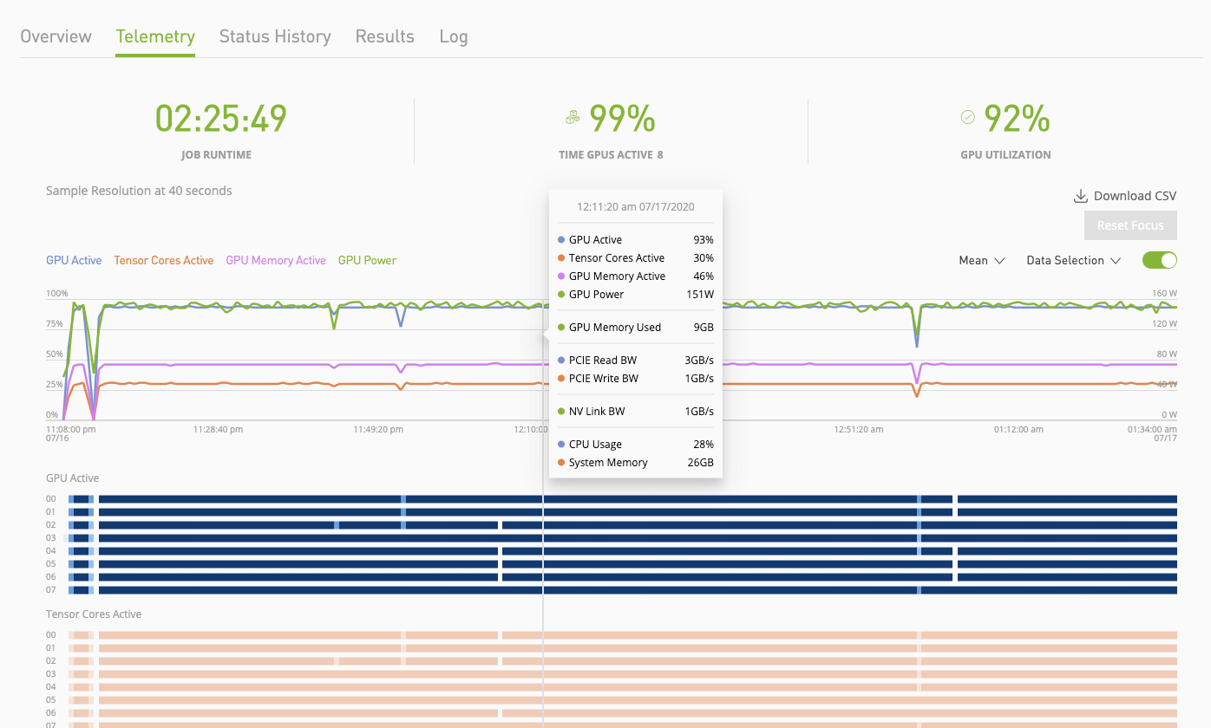
END user view
Notes:
To break the flow a bit I want to show one example view that comes of the first architecture we covered.
This is a view of the job telemetry the end user will see. At the top you can see the job runtime, the time GPUs are active and the average GPU utilization across the 8 GPUs being used by the Job.
Below that you can see line graph for the Avg. GPU metrics over time like GPU Active, Tensor Core Active, GPU memory and GPU power.
Here the GPU is kept busy with TC at 25%.
The Overlay breaks down the metrics at any point in time. You can see details like PCIe read and write bandwidth values, the NVlink Bandwidth, the CPU and memory usage.
The heat map below shows GPU’s utilization and the Tensor core usage for each GPU.

Slide 18
SCALE Challenges
Notes:
Lets now look at the scale challenges

Slide 19
Components and challenges
Component | Benefits | Challenges
Standard CNCF Components e.g. Prometheus, Influxdb, Graylog, Thanos | Many solutions exist Native cloud technologies. Strong community support Easily configurable | Sizing tuning High availability Scalability tuning Data durability
Notes:
Lets now look at some of the challenges we faced.
As you saw in the Architecture diagram, we used a lot of CNCF components. These are great as there are many solutions that exist and independently, they solve for a lot of our functional requirements. They are all native cloud technologies and have strong community support behind them. This allows them to continuously evolve with the growing needs of the community. This has been a life saver for us. Many a times just an upgrade of the stack got us the resolution for an issue and improved performance. All the components are also easily configurable via the stable helm charts.
However, there was a lot of trial and error involved in finding the right combination of components that would support our requirements. The community has many references for the integrations, and we were able to leverage these. We took a lot of the best practices and adapted them for our loads. We had to tune for size, high availability, scalability and data durability. Not only did we have to optimize the configurations, but we needed to get a good understanding of how to adapt them as the clusters grew.

Slide 20
Scaling prometheus
Aspect | What | Why | How
Sizing | OOM and CPU Throttling with load Performance | 2 hours data in memory Large series 55 m, 260K samples/min Long restart times | Optimize resource requests and limits for volume
High Availability | Uptime during pod restarts and upgrades | Long restart times | Added two replicas
Scalability | Nodes keep getting added to clusters | With limits on containers as load grows containers crashloop. | Resource requests and limits
Data Persistence | 2 week view | Storage in k8s is ephmeral | In cluster persistence and replication Remote read and write (influxdb and Thanos) Update Influxdb-relay and Influxdb
Data Durability | No data loss | Storage in k8s is ephmeral | Thanos sidecar/receiver Optimize setting for remote write for our loads
Notes:
Lets now look at how we optimized the components for our scale.
For Prometheus and the other components we had to understand the resource requests and limits that would work well for our loads with room to grow.
To size each component well we had to understand how it used the resources.
Prometheus, for example, keeps 2 hours of data in memory till it is compacted to disk. Prometheus size is dependent on the total number of series it is supporting. You can see some of our loads numbers here. At restarts it also loads WAL files, which depending on load can be large. This impacts the restart time of Prometheus as well as the memory usage.
We did rigorous load tests to get a baseline for the size of each component. This helped us avoid frequent failures in production. However due to the unpredictability or production environments we kept a close eye on the systems in production to ensure they did not hit OOM or CPU throttling errors. We do regular evaluations of our system to ensure that the sizing is working well. As we add nodes to the cluster we review these settings.
To make the system highly available we had to learn what load could be supported by Prometheus with acceptable restart times vs where we need to add another replica.
For Scaling Prometheus we rely on the sizing of the instances from our load tests. So far we have been able to manage each cluster with two instances with tunings on resources.
Then there were some trickier challenges we hit.
The first of these was Data persistence. We needed the metrics to always be available for viewing. For this we needed to add in-cluster persistence with replication. For this we used Influxdb for Remote read and write. This worked well upto a certain load after which we started seeing data gaps. To resolve this we had to look into the code of Prometheus and the down stream components. We found that Prometheus would drop metrics if the downstream components were not accepting metrics. With the 2.8 version where Prometheus introduced WAL for remote write this occurrence was reduced. But prior to that we had to optimize the downstream components so metrics did not get dropped. I will go into some more details of this in the next slide.
For Data durability we had to introduce Thanos Sidecar in one instance and Thanos Receiver in another. Thanos side car worked well for us but Thanos receiver was new and we hit a lot of challenges with it. With the updated version of Prometheus we had to optimize the max_samples, max shards, and capacity size to optimize based on the samples size of the cluster. Load test helped us get to the optimal settings for this.

Slide 21
Scaling Influxdb
Aspect | What | Why | How
Sizing | OOM and CPU Throttling with load Performance | Data kept in memory Large series 6 m, 200K samples/min Increased indexing for prometheus Long restart times | Optimize resource requests and limits for volume
High Availability | Uptime during pod restarts and upgrades | Long restart times | Added two replicas In cluster replication.
Scalability | Nodes keep getting added to clusters | With limits on containers as load grows containers crash loop. | Resource requests and limits Reduce retention to 3 days
Data Persistence and Durability | Long term view on data | Storage in k8s is ephemeral | In cluster replication Thanos sidecar/receiver
Job telemetry | No data loss to external systems | Buffers in Influxdb relay and Influxdb | Update code for service
Notes:
The influxdb tuning, for sizing, HA, scalability was similar to Prometheus. Influxdb keeps a lot of data in memory and restart times are long as the container reads the WAL files. We also found was that Influxdb did not scale well for Prometheus data which has a lot of labels which need to be indexed. Sizing had to consider these.
Due to the long restart times, for HA we need to add replicas. We added Influxdb-relay for replication. However Influxdb-relay is not supported any more, so we had to support it ourselves for our setup. This also helped for the data persistence requirements.
Sizing of the resources helped us support the scale. However, influxdb did not scale to support our min. retention requirement of 2 weeks. We could only support 3 days of retention with confidence. For getting longer retention we introduced Thanos sidecar in one setup and moved away from Influxdb to Thanos receiver in another.
As I mentioned we had added Influxdb in our architecture for data persistence in the cluster. Since this is a Kubernetes cluster, pods can restart for various reasons and land on new nodes. To persist data for Influxdb we are using host path persistent volumes. With pod restarts we could easily have pods land on different nodes and loose data. Our HA solution of in cluster replication helped here.
Here we had to ensure that the data we were sending to external system had no data gaps. This turned out to be a very hard issue to debug and solve for and needed detail investigation into the component codes to understand how best to solve it. The solution involved updates to the code of the services.

Slide 22
Scaling THanos
Aspect | What | Why | How
Sizing | OOM and CPU Throttling with load Performance | Many components to be tuned | Optimize resource requests and limits for volume
High Availability | Uptime during pod restarts and upgrades | Long restart times | Added replicas
Scalability | Nodes keep getting added to clusters | With limits on containers as load grows containers crash loop. | Resource requests and limits Update to Thanos 0.11 with GRPC
Data Persistence | 2-week view | Storage in k8s is ephemeral | Thanos sidecar and Thanos receiver
Data Durability | No data loss 1-year data retention | Storage in k8s is ephemeral | Thanos sidecar/receiver Optimize setting for remote write for our loads Down sampling
Notes:
Thanos which we used for Data durability comes with many components. Sizing for Thanos involved understanding each of these and how best to optimize them for our loads. For example for Thanos store we needed to set max cache size. For Thanos receiver we discovered that setting the tsdb minBlock and maxBlock to 15 min would reduced the wal size, which allowed us to reduce restart times and have Thanos receiver not use increasing amounts of memory.
HA was easily support by Thanos by optimizing the replicas for the components as needed.
For Scale in Thanos Receiver we had to move to the GRPC version.
Thanos helped us solve the issue of data durability and data persistence. Data in a kubernetes cluster is ephemeral. Thanos sidecar sends data to an object store repository. This component is fairly robust and gave us data durability for data persisted to disk. This, in Prometheus, is every 2 hours and we used Influxdb for the immediate time window. This worked well.
However, in the variant architecture that I showed where we used Thanos receiver, we hit a lot of issues with load. We had to delve into the code and figure out the root cause and then see how best to solve for it. Luckily, we were able to upgrade Prometheus and Thanos versions and tune the configurations to solve for our loads. We had to again do rigorous load test to setup the max_shards, max_samples, and capacity for Prometheus remote write for our loads. Downsampling allowed us to support longer data retention and querying.

Slide 23
Scaling Graylog
Aspect | What | Why | How
Sizing | OOM and CPU Throttling with load Performance | Many components to be tuned Load 1.6Tb/day 12K logs/sec Has a Journal | Optimize resource requests and limits for volume Raid 0
High Availability | Uptime during pod restarts and upgrades | Long restart times | Added replicas
Scalability | Nodes keep getting added to clusters | With limits on containers as load grows containers crash loop. | Resource requests and limits
Data Persistence | 6 months of data | Storage in k8s is ephemeral | Added Persistent Volume for Journal In cluster replication
Notes:
In some of our deployments we used Graylog for logging. Graylog uses ElasticSearch and Mongodb underneath. Each had to be separately understood and tuned. (Load tests helped but we also have a lot of battle scares.)
For Sizing we had to look at how to tune each component. These are written in java so we had to optimize the heap size and the container sizes. We also learnt that we had to set the cpu limit as without it java containers default to just 1 cpu.
For high availability initially we just added replicas. Though ES and Mongodb did fairly well with the default replicas, Graylog performance seemed to do better with more replicas.
As our loads grew we quickly hit scale issues with Graylog. Just adding replicas did not help. We had to look at sizing as well. We learnt that there was a heap size recommended for ES that made it perform optimally.
For Data persistence we added persistent volume for Graylog Journal. Data written to ES was already well managed.
Graylog with ES handles data durability well.

Slide 24
USER Views

Slide 25
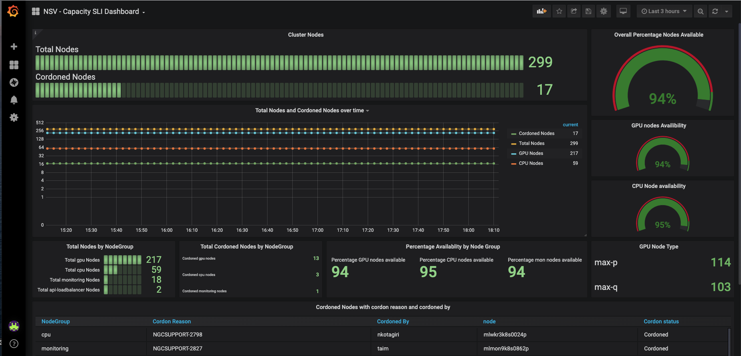
ADMIN user view
Notes:
Here is an example of an NSV Admin view. The Capacity Dashboard.
It shows the cluster capacity with total nodes in the cluster and the total number of nodes cordoned at the top. And below that it shows the cordoned nodes by node type.
On the right-hand side it shows the availability of the different types of nodes in the system.
With this Admin users can get a good view into the cluster capacity.

Slide 26
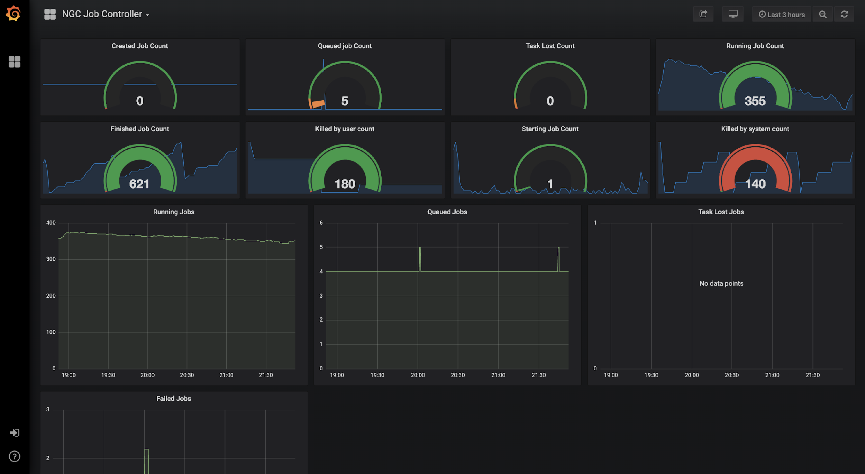
DEveloper view
Notes:
This view shows the NSV Developers view for the Job Controller.
The pie charts at the top show the counts of jobs in different states and below that we see the timelines for jobs in the various states - running , queued, task lost and failed. This gives a good view to the developers for the current state of the Job controller.

Slide 27
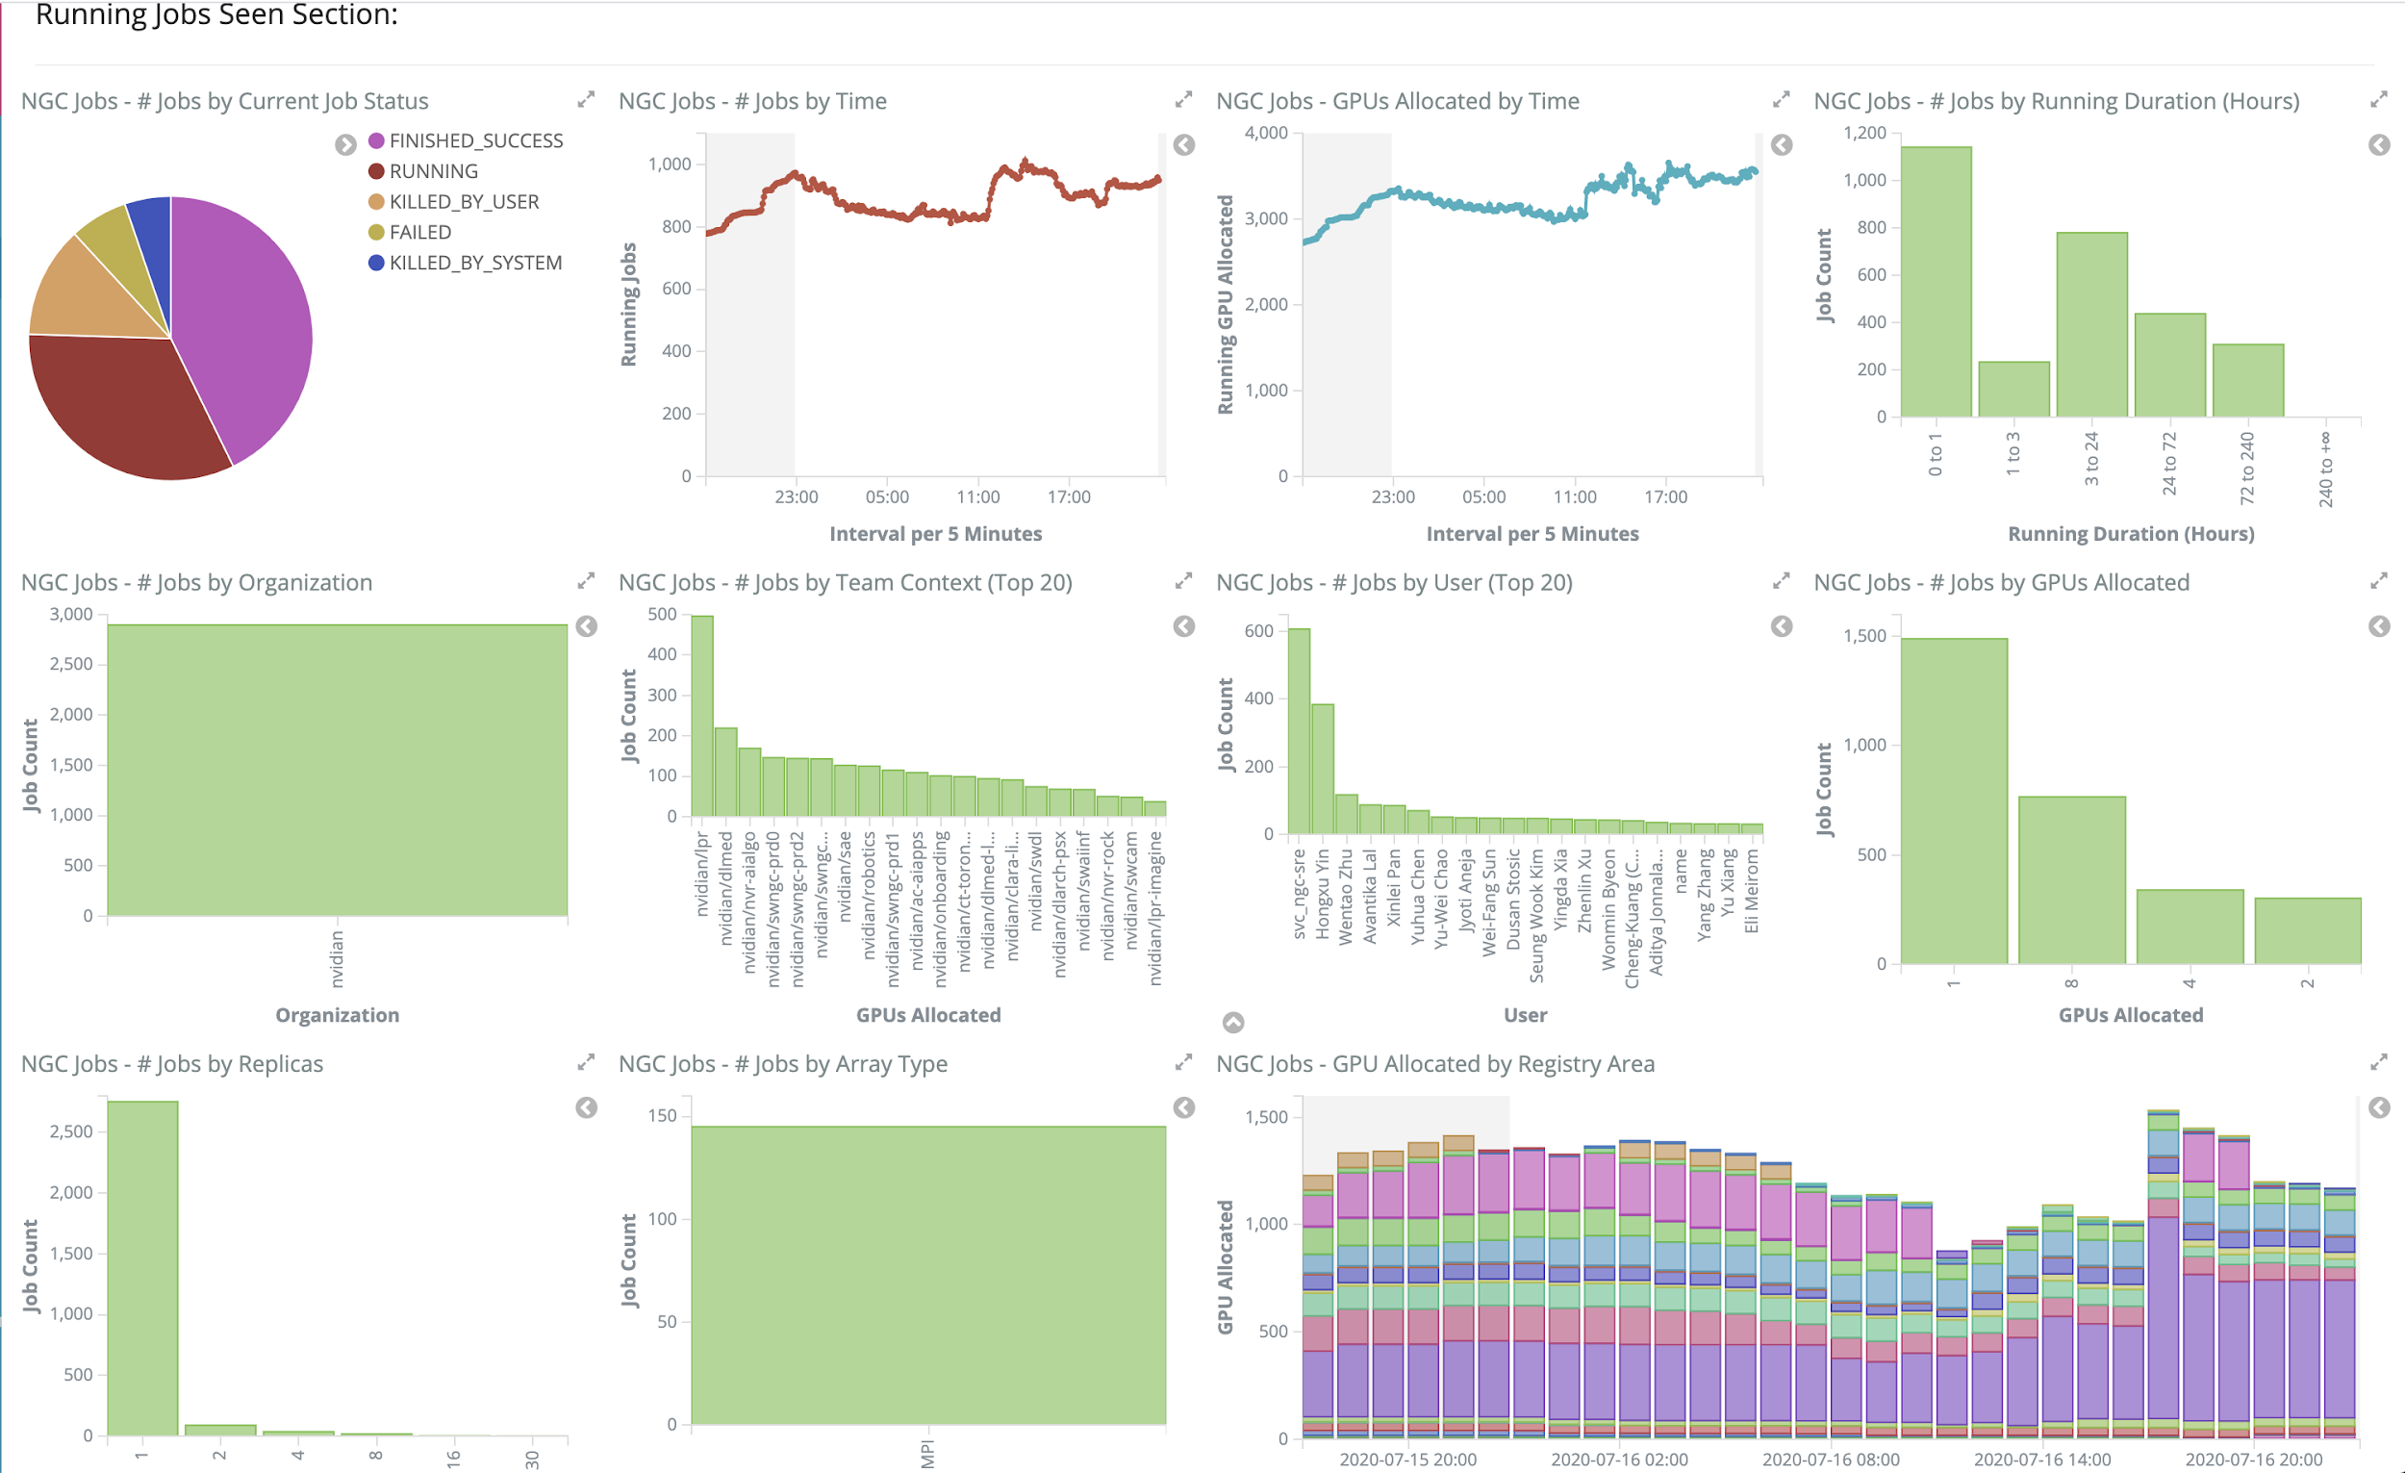

STakeholder view
Notes:
This is our stakeholders view. The pie chat at the top left shows jobs in different states at the moment. Then we have timelines of jobs running by time, by GPUs allocated, running duration, by Org, by team, by registry area etc..

Slide 28
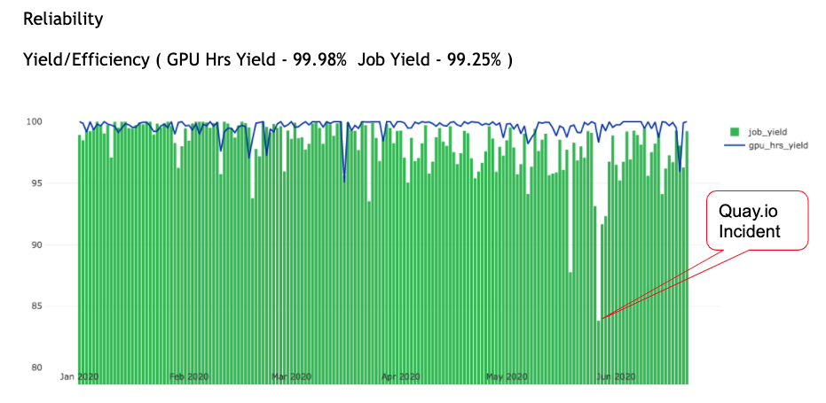
Stakeholder view
Notes:
And finally this is a Yield Dashboard. It shows the yield by jobs (the green bars) and GPU hours (the blue line). You can see the dips in both when we have issues in our cluster e.g. when Quay.io was down, users could not download their job containers, this in turn caused our yield to drop.

Slide 29
Thank You

Slide 30
Q&A

